Slide 1
Chapter 6 Modeling of 3D Graphics Objects
Resumes of the book
Computer Graphics using Java 2D and 3D
Computação Gráfica
Prof. Carlos Carreto
Engenharia Informática
Instituto Politécnico da Guarda

Slide 2
Objectives
Understand the basic attributes of graphical objects: Geometry and Appearance.
Describe the representation of points and vectors.
Apply the classes of the GeometryArray family to construct geometries.
Apply the GeometryInfo class to construct geometries.
Use geometric primitives.
Use text and fonts as geometric objects.
Use the Appearance class and associated node-component classes.

Slide 3
Points and Vectors
The basic element of geometric modeling is the point.
It is common to represent points by vectors.
The vectors are also used to represent measures with directions and ways, such as forces, speeds and accelerations.

Slide 4
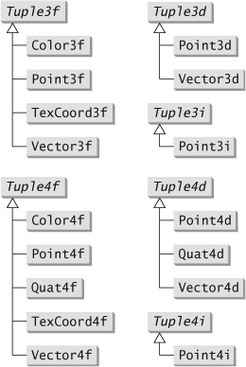
Points and Vectors
The javax.vecmath package included in the Java 3D API distribution, contains an extensive set of classes to represent points, vectors, and arrays.
Many of the Java 3D API methods use objects from these classes.
Point3d p1 = new Point3d(1.0, 2.3, 0.0);
Point3d p2 = new Point3d(0.0, –0.5, 1.2);
double dist = p1.distance(p2);
Vector3f v1 = new Vector3f(1.0, 2.3, 0.0); Vector3f v2 = new Vector3f(0.0, –0.5, 1.2); double angle = v1.angle(v2);
4

Slide 5
Modeling of Geometric Shapes
The geometric shapes of 3D objects are typically modeled as points, lines and surfaces.
Line
Point
Surface
5

Slide 6
Modeling of Geometric Shapes
Dots and lines (including curves) are simple to define in 3D. They are usually simple extensions of the corresponding 2D models.
Surface modeling is much more complex.
Implicit Equation
Parametric Equation
Due to the obvious complexity in representing an arbitrary 3D surfaces, they are usually approximated by a collection of simpler surfaces.
6

Slide 7
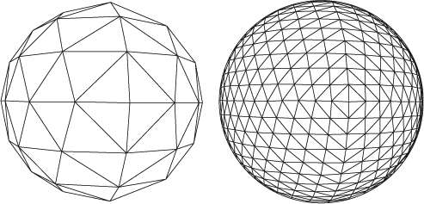
Representation of Surfaces through Polygons
Approximate sphere (with different resolutions) by a mesh of polygons (triangles).
7

Slide 8
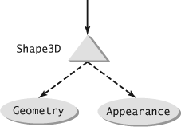
The Shape3D Node
In a Java 3D scene graph, a visual object is usually represented by a leaf node of type Shape3D.
The Shape3D object references a Geometry object that defines the shape and other geometric characteristics of the visual object.
The Shape3D object also references an Appearance object to set its appearance in rendering.
Appearance ap = new Appearance();
ap.setMaterial(new Material());
Font3D font = new Font3D(new Font("SansSerif",
Font.PLAIN, 1), new FontExtrusion());
Text3D text = new Text3D(font, "Hello 3D");
Shape3D shape = new Shape3D(text, ap);
8

Slide 9
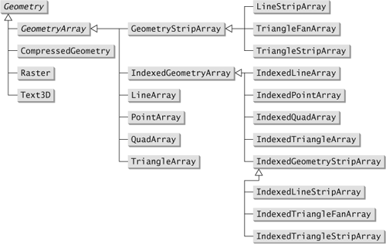
Geometry Class
9

Slide 10
GeometryArray Classes Family
Provide functionalities for constructing geometries directly from arrays of points, lines and polygons.
Define the vertices and specify the structural relationship between them.
Define also other data types such as normal vectors, colors, and texture coordinates.
The specification of data to be used is done through constant bit mask:
COORDINATES
NORMALS
COLOR_3
COLOR_4
TEXTURE_COORDINATE_2
TEXTURE_COORDINATE_3
TEXTURE_COORDINATE_4
10

Slide 11
Geometry Class
11

Slide 12
PointArray
2
0
1
PointArray pa = new PointArray(3, GeometryArray.COORDINATES);
pa.setCoordinate(0, new Point3f(0f, 0f, 0f));
pa.setCoordinate(1, new Point3f(1f, 0f, 0f));
pa.setCoordinate(2, new Point3f(0f, 1f, 0f));
Each vertex specifies a point in the geometry.
Each Individual coordinate is added using setCoordinate.
12

Slide 13
LineArray
1
3
4
0
2
5
LineArray la = new LineArray(6, GeometryArray.COORDINATES);
Point3f[] coords = new Point3f[6];
coords[0] = new Point3f(0f, 0f, 0f);
coords[1] = new Point3f(1f, 1f, 0f);
coords[2] = new Point3f(1f, 0f, 0f);
coords[3] = new Point3f(2f, 1f, 0f);
coords[4] = new Point3f(2f, 1f, 0f);
coords[5] = new Point3f(3f, 0f, 0f);
la.setCoordinates(0, coords);
Each vertex pair specifies a line segment in the geometry.
The total set of coordinates is added using setCoordinates.
13

Slide 14
TriangleArray
1
4
0
2
3
5
TriangleArray ta = new TriangleArray(6, GeometryArray.COORDINATES);
Point3f[] coords = new Point3f[6];
coords[0] = new Point3f(0f, 0f, 0f);
coords[1] = new Point3f(1f, 1f, 0f);
coords[2] = new Point3f(1f, 0f, 0f);
coords[3] = new Point3f(1f, 0f, 0f);
coords[4] = new Point3f(2f, 1f, 0f);
coords[5] = new Point3f(3f, 0f, 0f);
ta.setCoordinates(0, coords);
Each group of three vertices specifies a triangle in geometry.
14

Slide 15
TriangleArray
Definition of the geometry of a cone with TriangleArray.
float h = 2f;
float w = 1f;
int n = 60; // number of triangle patches
TriangleArray ta = new TriangleArray(3*n, GeometryArray.COORDINATES);
Point3f apex = new Point3f(0, h, 0);
Point3f p1 = new Point3f(w, 0, 0);
int count = 0;
for (int ii = 1; ii <= n; ii++) {
float x = (float)(w*Math.cos(ii*2*Math.PI/n));
float z = (float)(w*Math.sin(ii*2*Math.PI/n));
Point3f p2 = new Point3f(x, 0, z);
ta.setCoordinate(count++, apex);
ta.setCoordinate(count++, p1);
ta.setCoordinate(count++, p2);
p1 = p2;
}
15

Slide 16
QuadArray
3
5
2
4
6
7
0
1
QuadArray qa = new QuadArray(8, GeometryArray.COORDINATES);
Point3f[] coords = new Point3f[8];
coords[0] = new Point3f(0f, 0f, 0f);
coords[1] = new Point3f(1f, 0f, 0f);
coords[2] = new Point3f(1f, 1f, 0f);
coords[3] = new Point3f(0f, 1f, 0f);
coords[4] = new Point3f(1f, 1f, 0f);
coords[5] = new Point3f(0f, 1f, 0f);
coords[6] = new Point3f(0f, 1f, 1f);
coords[7] = new Point3f(1f, 1f, 1f);
qa.setCoordinates(0, coords);
Each group of four vertex specifies a quadrilateral in geometry.
16

Slide 17
Setting Other Attributes
TriangleArray ta = new TriangleArray(6, GeometryArray.COORDINATES | GeometryArray.COLOR_3);
Point3f[] coords = new Point3f[6];
coords[0] = new Point3f(0f, 0f, 0f);
coords[1] = new Point3f(1f, 1f, 0f);
coords[2] = new Point3f(1f, 0f, 0f);
coords[3] = new Point3f(1f, 0f, 0f);
coords[4] = new Point3f(2f, 1f, 0f);
coords[5] = new Point3f(3f, 0f, 0f);
ta.setCoordinates(0, coords);
Color3f[] colors = new Color3f[6];
colors[0] = new Color3f(1f, 0f, 0f);
colors[1] = new Color3f(0f, 1f, 0f);
colors[2] = new Color3f(0f, 0f, 1f);
colors[3] = new Color3f(1f, 1f, 0f);
colors[4] = new Color3f(0f, 1f, 1f);
colors[5] = new Color3f(1f, 0f, 1f);
ta.setColors(0, colors);
17

Slide 18
Setting Other Attributes
QuadArray qa = new QuadArray(8, GeometryArray.COORDINATES | GeometryArray.NORMALS);
Point3f[] coords = new Point3f[8];
coords[0] = new Point3f(0f, 0f, 0f);
coords[1] = new Point3f(1f, 0f, 0f);
coords[2] = new Point3f(1f, 1f, 0f);
coords[3] = new Point3f(0f, 1f, 0f);
coords[4] = new Point3f(1f, 1f, 0f);
coords[5] = new Point3f(0f, 1f, 0f);
coords[6] = new Point3f(0f, 1f, 1f);
coords[7] = new Point3f(1f, 1f, 1f);
qa.setCoordinates(0, coords);
Vector3f[] normals = new Vector3f[8];
normals[0] = new Vector3f(0f, 0f, 1f);
normals[1] = new Vector3f(0f, 0f, 1f);
normals[2] = new Vector3f(0f, 0f, 1f);
normals[3] = new Vector3f(0f, 0f, 1f);
normals[4] = new Vector3f(0f, 1f, 0f);
normals[5] = new Vector3f(0f, 1f, 0f);
normals[6] = new Vector3f(0f, 1f, 0f);
normals[7] = new Vector3f(0f, 1f, 0f);
qa.setNormals(0, normals);
18

Slide 19
Face Rendering
A polygon has an "inside face" and an "outside face".
By default Java 3D only renders the outside face.
Inside Face
Outside Face
19

Slide 20
Face Rendering
When facing a given face, this side that we see will be considered "outside“, if the vertices are indicated in the anti-clockwise direction and will be considered "inside“, if the vertices are indicated in the clockwise direction.
20

Slide 21
Geometry Class
21

Slide 22
GeometryStripArray
Often a vertex is shared by several polygons.
In order not to add these vertices more than once, the GeometryStripArray class uses the idea of strips to allow the sharing of adjacent vertices.
To define separate strips, the number of vertices in each strip is specified with an array of integers in the class constructor, or through the method:
void setStripVertexCounts(int[] stripVertexCounts);
22

Slide 23
GeometryStripArray
1
3
0
2
4
//2 line strips, com 2 e 3 vértices respectivamente
int[] stripVertexCounts = {2, 3};
LineStripArray lsa = new LineStripArray(5, GeometryArray.COORDINATES, stripVertexCounts);
Point3f[] coords = new Point3f[5];
coords[0] = new Point3f(0f, 0f, 0f);
coords[1] = new Point3f(1f, 1f, 0f);
coords[2] = new Point3f(1f, 0f, 0f);
coords[3] = new Point3f(2f, 1f, 0f);
coords[4] = new Point3f(3f, 0f, 0f);
lsa.setCoordinates(0, coords);
23

Slide 24
GeometryStripArray
2 stripes, one with 5 vertices and the other with 4.
TriangleStripArray
Using the TriangleStripArray class, the first triangle is formed with the first three vertices and the next triangle is formed with the next vertex and the two previous vertices.
24

Slide 25
GeometryStripArray
Using the TriangleFanArray class, the first vertex of each stripe is common to all triangles of that stripe. At each two vertices, a triangle is formed along with the first vertex.
2 stripes, one with 6 vertices and the other with 4 vertices.
TriangleFanArray
25

Slide 26
GeometryStripArray
Definition of the geometry of a cone with TriangleFanArray.
float h = 2f;
Float w = 1f;
int n = 60; // number of triangle patches
int[] stripVertexCounts = {n+2}; // 1 strip com n+2 vertices
TriangleFanArray tfa = new TriangleFanArray (n+2, GeometryArray.COORDINATES, stripVertexCounts);
Point3f apex = new Point3f(0, h, 0);
tfa.setCoordinate(0, apex);
for (int ii = 0; ii <= n; ii++) {
float x = (float)(w*Math.cos(ii*2*Math.PI/n));
float z = (float)(w*Math.sin(ii*2*Math.PI/n));
Point3f p = new Point3f(x, 0, z);
tfa.setCoordinate(ii+1, p);
}
26

Slide 27
Geometry Class
27

Slide 28
IndexedGeometryArray
Another way to avoid vertex duplication.
Instead of defining a polygon by directly defining its vertices, the IndexedGeometryArray class allows we to specify vertex indexes in an array of points.
In this way the vertices only have to be specified once (in the array of points), but can be referenced several times through the corresponding indexes.
Other attributes such as colors and normal vectors can also be indexed in the same way.
28

Slide 29
IndexedGeometryArray
3
2
4
5
0
1
IndexedQuadArray iqa = new IndexedQuadArray (6, GeometryArray.COORDINATES, 8);
Point3f[] coords = new Point3f[6];
coords[0] = new Point3f(0f, 0f, 0f);
coords[1] = new Point3f(1f, 0f, 0f);
coords[2] = new Point3f(1f, 1f, 0f);
coords[3] = new Point3f(0f, 1f, 0f);
coords[4] = new Point3f(0f, 1f, 1f);
coords[5] = new Point3f(1f, 1f, 1f);
iqa.setCoordinates(0, coords);
int[] indices = {0, 1, 2, 3, 2, 3, 4, 5};
iga.setCoordinateIndices(0, indices);
29

Slide 30
Geometry Class
30

Slide 31
IndexedGeometryStripArray
It combines the functionality of index arrays and strip arrays.
It allows the use of indexes to define strips.
To define separate strips, the number of vertices in each strip is indicated by an array of integers in the class constructor, or by the method:
void setStripIndexCounts(int[] stripIndexCounts);
31

Slide 32
IndexedGeometryStripArray
2
3
0
4
1
6
5
int[] stripIndexCounts = {4, 4}; //2 strips, cada um com 4 vertices
IndexedTriangleStripArray itsa = new IndexedTriangleStripArray(7,
GeometryArray.COORDINATES, 8, stripIndexCounts);
Point3f[] coords = new Point3f[7];
coords[0] = new Point3f(0f, 0f, 0f);
coords[1] = new Point3f(1f, 0f, 0f);
coords[2] = new Point3f(1f, 1f, 0f);
coords[3] = new Point3f(2f, 1f, 0f);
coords[4] = new Point3f(-1f, 0f, 0f);
coords[5] = new Point3f(-1f, -1f, 0f);
coords[6] = new Point3f(-2f, -1f, 0f);
itsa.setCoordinates(0, coords);
int[] indices = {0, 1, 2, 3, 0, 4, 5, 6};
itsa.setCoordinateIndices(0, indices);
32

Slide 33
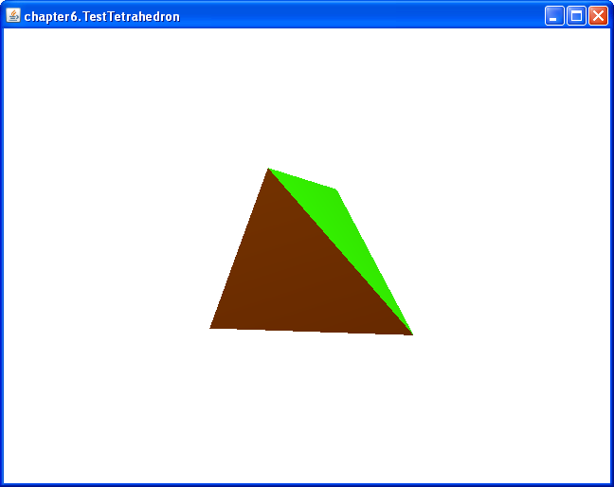
Construction of a Tetrahedron
Code 6.1
Code 6.2
Run
33

Slide 34
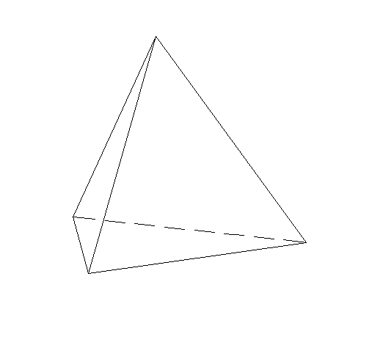

Construction of a Tetrahedron
Normal vetors of the vertices of the face 0, 1, 2 -> (n, n, -n)
One of the five regular polyhedral.
Vertices
(1, 1, 1), (1, -1, -1), (-1, 1, -1), (-1, -1, 1)
Index
0, 1, 2, 0, 3, 1, 1, 3, 2, 2, 3, 0
Normal vectors
$$n=\frac{1}{\sqrt{3}}$$
0
2
3
1
34

Slide 35
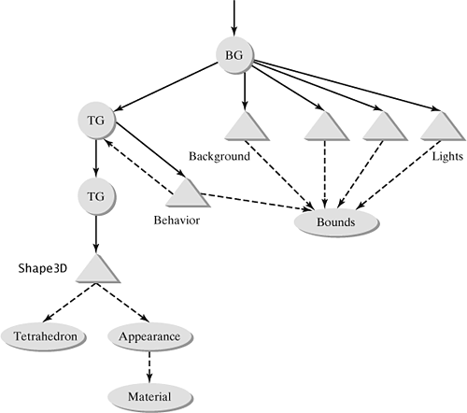
Construction of a Tetrahedron
TransformGroup for animation (rotation about axis YY)
TransformGroup for the initial positioning of the shape.
35

Slide 36
Construction of a Tetrahedron
TransformGroup spin = new TransformGroup();
spin.setCapability(TransformGroup.ALLOW_TRANSFORM_WRITE);
root.addChild(spin);
. . .
spin.addChild(tg);
tg.addChild(shape);
Alpha alpha = new Alpha(-1, 4000);
RotationInterpolator rotator = new RotationInterpolator(alpha, spin);
BoundingSphere bounds = new BoundingSphere();
rotator.setSchedulingBounds(bounds);
spin.addChild(rotator);
36

Slide 37
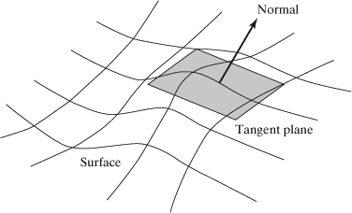
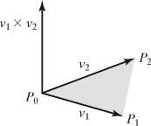
Normals
Normal vectors to surfaces are important geometric attributes that are used in sophisticated rendering modes such as when the scene is illuminated.
The normal vector of a surface at a given point is the vector perpendicular to the tangent plane at that point.
A normal vector can be calculated through the cross product of two vectors

Slide 38
Calculation of Normal Vectors
Example of the calculation of a normal vector to a plane defined by 3 points:
Point3f p0 = new Point3f(1,1,1);
Point3f p1 = new Point3f(1,-1,-1);
Point3f p2 = new Point3f(-1,1,-1);
p1.sub(p0);
p2.sub(p0);
Vector3f v1 = new Vector3f(p1);
Vector3f v2 = new Vector3f(p2);
Vector3f normal = new Vector3f();
normal.cross(v1, v2);
normal.normalize();

Slide 39
Calculation of Normal Vectors
For geometries formed by flat faces, such as the anterior tetrahedron, the normal vectors of the vertices can be calculated separately using the cross product of two vectors seen in a previous slide.
For an approximate surface by a mesh of polygons, the normal vector of a given vertex should be calculated from the original mathematical definition of the surface, instead of from the polygons, in order to obtain a more accurate normal vector.

Slide 40
Calculation of Normal Vectors
Parametric equation of a surface:
Two vectors of the plane tangent to the surface can be obtained from the derivatives:
The normal vector of the surfaces at a given point is obtained from the cross product of the two vectors:
40

Slide 41
Calculation of Normal Vectors
Parametric equation of the surface:
x = u cos v
y = u sin v
z = u²
Derivatives:
(cos v, sin v, 2u)
(–u sin v, u cos v, 0)
The normal vector at the point of the surface, defined by (u, v) is:
(cos v, sin v, 2u) x (–u sin v, u cos v, 0) =
(–2u² cos v, 2u² sin v, u)
41

Slide 42
GeometryInfo Class
Alternative to GeometryArray classes for generating geometries.
Allows definition of more generic polygonal faces (with more than 4 vertices).
Allows automatic generation of normal vectors through the class NormalGenerator.
Allows the conversion of a given geometry into strips through the Stripifier class.

Slide 43
GeometryInfo Class
One of the constructors is parameterized by an object of type GeometryArray, thus allowing the conversion of this object to an object of type GeometryInfo :
public GeometryInfo(GeometryArray ga)
The other constructor creates an empty GeomtryInfo object with a given primitiveType :
public GeometryInfo(int primitiveType)
The primitiveType can be:
TRIANGLE_ARRAY
TRIANGLE_FAN_ARRAY
TRIANGLE_STRIP_ARRAY
QUAD_ARRAY
POLYGON_ARRAY

Slide 44
GeometryInfo Class
Triangle and quad arrays are interpreted in the same way as in the case of the GeometryArray classes.
To configure the coordinates of the vertices:
void setCoordinates(Point3f[] coords)
To use indexes:
void setCoordinateIndices(int[] indices)
void setNormalIndices(int[] indices)
void setColorIndices(int[] indices)
void setTextureCoordinateIndices(int[] indices)
To define more than one strip, an array of integers is used to indicate the number of strips and the number of vertices of each.

Slide 45
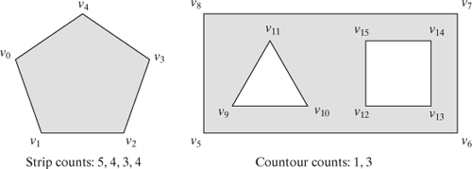
GeometryInfo Class
GeometryInfo objects created with the POLYGON_ARRAY flag allow you to define more complex polygons with more than 4 sides and optionally with openings.
A polygon consists of one or more contours. The first contour defines the outer boundary of the polygon and the subsequent contours define the apertures.
Two integer arrays specify the number of vertices of each contour and the number of contours for each polygon.
There are 4 stripes, with 5, 4, 3 and 4 vertices respectively.
There are 2 polygons. The first is defined by 1 contour and the second by 3 contours. So the second polygon has 2 openings.

Slide 46
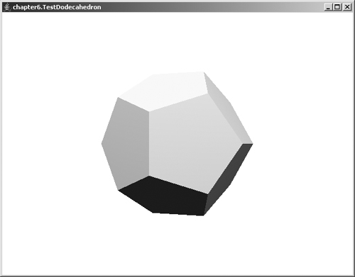
GeometryInfo Class
Code 6.3
Code 6.4
Run

Slide 47
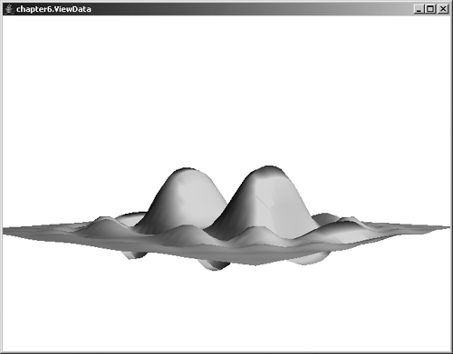
Creating a Polygon Mesh
Code
Run

Slide 48
Creating a Polygon Mesh
x = f (u, v)
y = g(u, v)
z = h(u, v)
Vertices
Quadrilateral
Triangles

Slide 49
Creating a Polygon Mesh

Slide 50
Creating a Polygon Mesh
(x, y, z)
a
c
m
n
b
X
d
Z

Slide 51
Creating a Polygon Mesh
GeometryInfo gi = new GeometryInfo(GeometryInfo.TRIANGLE_STRIP_ARRAY);
gi.setCoordinates(pts);
gi.setCoordinateIndices(coords);
gi.setStripCounts(stripCounts);
(x, y, z)
a
c
m
n
b
d
X
Z

Slide 52
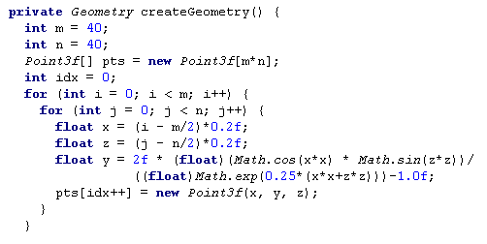
Creating a Polygon Mesh
m x n unique vertices
(x, y, z)
a
c
m
n
b
d
X
Z

Slide 53
Creating a Polygon Mesh
2n coordinates indices per stripe
2n(m-1) total
a
c
m
n
b
X
d
Z
m-1 stripes

Slide 54
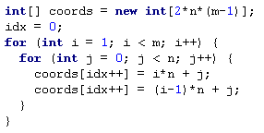
Creating a Polygon Mesh
Coordinate indices per stripe
a
c
m
n
0
n
b
1
X
d
n+1
Z
. . .
n-1

Slide 55
Creating a Polygon Mesh
Index sequence to create the stripe: n, 0, n+1, 1, . . .
a
c
m
n
0
n
b
1
X
d
n+1
Z
. . .
n-1

Slide 56
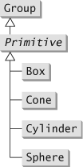
Primitives
The Java 3D API contains classes that implement a set of common geometric primitives.
The Primitive class is a subclass of Group, so the objects can be added directly to the scene graph as Group nodes.

Slide 57
Primitives
The size of the primitives can be chosen through the respective constructors:
Box(float xdim, float ydim, float zdim, Appearance appearance)
Cone(float radius, float height)
Cylinder(float radius, float height)
Sphere(float radius)
The appearance of the primitives can be configured through the methods:
void setAppearance()
void setAppearance(Appearance appearance)
void setAppearance(int subpart, Appearance appearance)

Slide 58
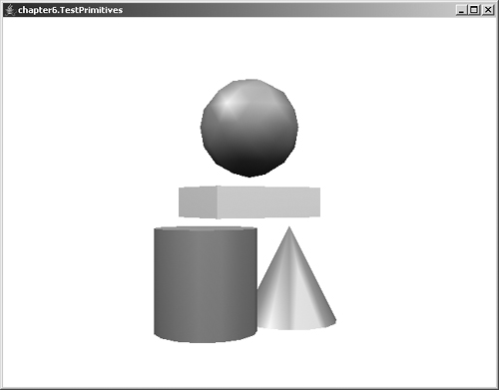
Primitives
Code
Run

Slide 59
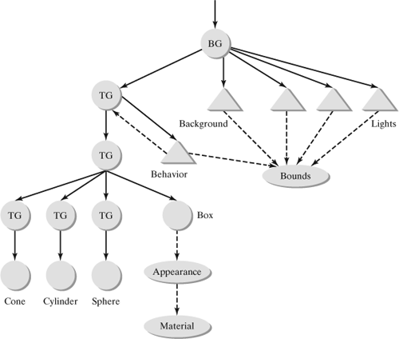
Primitives

Slide 60
Fonts and Text
To create a Text3D Object
Font font = new Font(“Serif”, Font.BOLD, 1);
FontExtrusion extrusion = new FontExtrusion();
Font3D font3d = new Font3D(font, extrusion);
Text3D text = new Text3D(font3d, “Hello”);
To create a Text2D Object
Text2D text = new Text2D(“Hello”, Color.blue, “Serif”, 16, Font.Italic);

Slide 61
Appearance and Attributes
In addition to geometry, graphical objects have attributes that define their appearance.
Based on color:
Single color
Color interpolated from the color of the vertices.
Realistic color (determined taking into account the reflective properties of the object, its geometry, light sources, emissive light, ambient light and point of view).
Based on Texture:
Texture mapping is another powerful technique for realistic appearance.

Slide 62
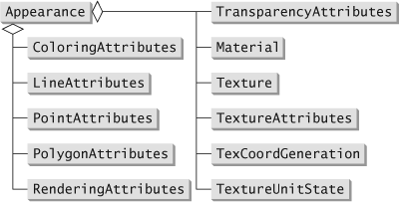
Appearance and Attributes
Attributes related to a given object are specified through an Appearance object.
The Appearance object usually contains a set of references to objects that define the appearance.

Slide 63
ColoringAttributes
Sets the color to be used to color the object.
It is ignored if colors have been set for the vertices, or if the scene is illuminated.
It also defines the shading model:
SHAD_FLAT
SHAD_GOURAUD
SHAD_FASTEST
SHAD_NICEST

Slide 64
ColoringAttributes
Sphere sphere = new Sphere();
Appearance ap = new Appearance();
Color3f col = new Color3f(0.0f, 0.0f, 1.0f);
ColoringAttributes ca = new ColoringAttributes(col, ColoringAttributes.NICEST);
ap.setColoringAttributes(ca);
sphere.setAppearance(ap);

Slide 65
PointAttributes
Defines attributes related to rendering points.
Allows the specification of the size of the points and the use of antialiasing.
Appearance app = new Appearance( );
PointAttributes pta = new PointAttributes( );
pta.setPointSize(10.0f);
pta.setPointAntialiasingEnable(true);
app.setPointAttributes(pta);

Slide 66
LineAttributes
Defines attributes related to line rendering.
Lets you specify the width and the use of antialiasing.
It also allows you to specify the line pattern:
PATTERN_SOLID
PATTERN_DASH
PATTERN_DOT
PATTERN_DASH_DOT
PATTERN_USER_DEFINED

Slide 67
LineAttributes
LineAttributes myLA = new LineAttributes( );
myLA.setLineWidth(10.0f);
myLA.setLinePattern(LineAttributes.PATTERN_SOLID);
myLA.setLineAntialiasingEnable(true);
Appearance myAppear = new Appearance( );
myAppear.setLineAttributes(myLA);

Slide 68
PolygonAttributes
Defines attributes related to rendering polygons.
Controls how polygons are drawn. There are 3 modes:
POLYGON_POINT
POLYGON_LINE
POLYGON_FILL

Slide 69
PolygonAttributes
Appearance app = new Appearance( );
PolygonAttributes pa = new PolygonAttributes( );
pa.setCullFace(PolygonAttributes.CULL_NONE);
pa.setPolygonMode(PolygonAttributes.POLYGON_FILL);
app.setPolygonAttributes(pa);

Slide 70
TransparencyAttributes
Sets the level of transparency to use when rendering an object.
int tMode = TransparencyAttributes.BLENDED;
float tValue = 0.6f;
TransparencyAttributes ta = new TransparencyAttributes(tMode, tValue);
Appearance ap = new Appearance();
ap.setTransparencyAttributes(ta);

Slide 71
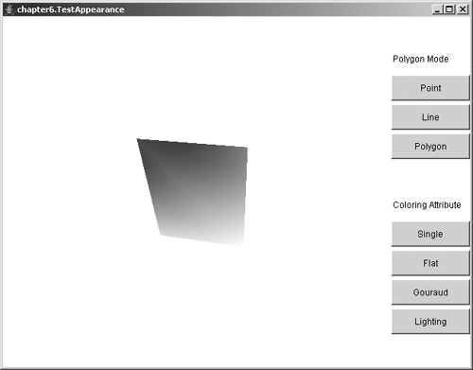
Testing Different Appearance Attributes
Code
Run

